Slide 1
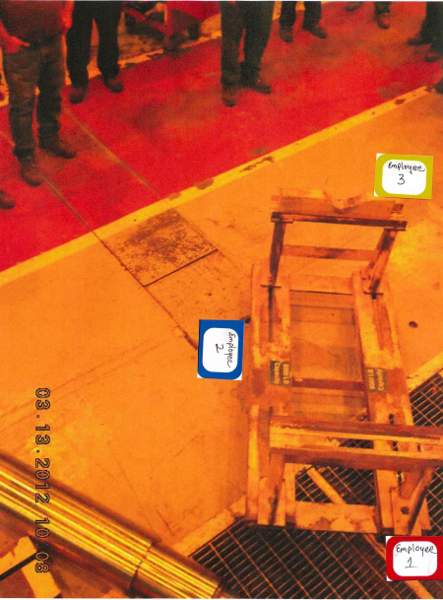
HS&E INCIDENT BULLETIN |  | 2nd Quarter 2012
Type of Incident | Fracture
Summary:
Employee sustained a foot injury when a mandrel that was being moved on a rotor cart tipped over. Employee was transported to the emergency room for treatment. Employee sustained lacerations and facture to the foot.
Root Causes: | Actions Taken Thus Far: Next Steps
The weight of the Mandrel Floor plates (cut out corner and unsecured) The unsecured cradle Size of cart wheels | Use only pipe mandrels Secure plate and fill corners in floor Secure cradles to cart Make the cradles deeper Increase size of wheels

